Slide 1
Android Development
Android In a Nutshell

Slide 2
Agenda
Android Overview
Android System
Linux Kernel
Native System
Android Runtime
Application Framework
Android Application
How Android Works

Slide 3

Android Ecosystem
The mobile market is a rapidly changing landscape with many players who often have diverging goals.
Mobile Operator
Mobile operators want to lock down their networks, controlling and of course metering traffic.
Device Manufactures
Device manufacturers want to differentiate themselves with features, reliability and price-points.
Software Vendors
Software vendors want unfettered access to the metal to deliver cutting edge applications.
Consumer
Then layer on to that a demanding user base, both consumer and corporate, that has become addicted to the “free phone”,

Slide 4
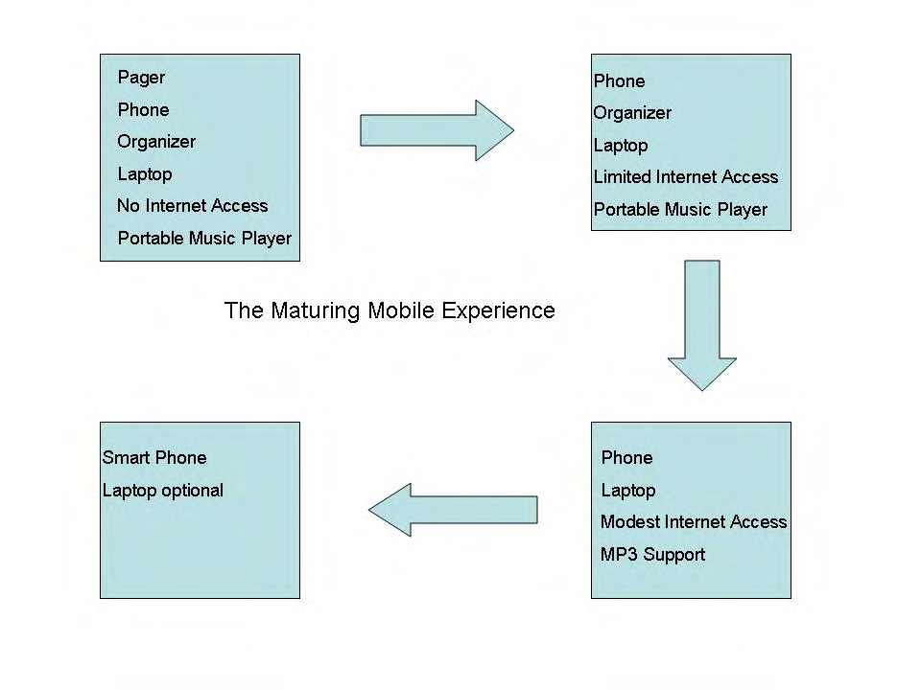
Business Motivation @ Mobile OS
There is a need to have a smart mobile platform to satisfy the diverse requests
In the end, we only regret the chances we didn’t take.

Slide 5
What Android
Android is a software environment but NOT a hardware platform.
Android is a software stack that includes an operating system, middleware and key applications.
The Android SDK provides the tools and APIs for developer to develop app with Java

Slide 6

Why Android is so popular
The most notable feature of Android is that it is an open source platform, therefore missing elements can and will be provided by the global developer community.
https://source.android.com/
https://android.googlesource.com/

Slide 7
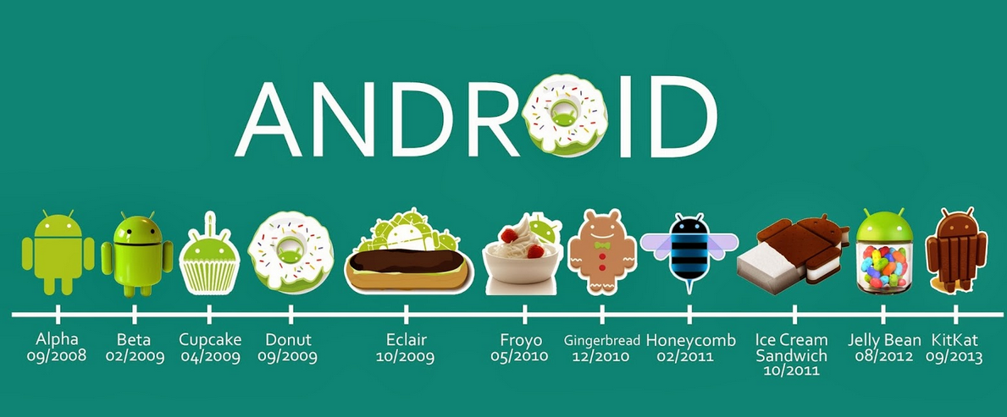

Roadmap

Slide 8
Platform and Hardware Requirements
In principle:
Android runs on top of Linux
Therefore: if it runs Linux, it can run Android
Known to have been made to work on:
ARM
x86
MIPS
…
Put in all sort of devices:
Washers, micro-wave ovens, car systems, watch, TV, etc.

Slide 9
In compliance with CDD --Compatibility Definition Document
Software: MUST conform to AOSP
Application Packaging Compatibility: support “.apk” files
Multimedia Compatibility: decoders, encoders, recording, ...
Developer Tool Compatibility: adb, ddms, Monkey
etc
Hardware Compatibility:
Display and Graphics, Input Devices, Data Connectivity, Cameras, Memory and Storage, USB, etc
Performance Compatibility
Security Model Compatibility
Software Compatibility Testing – CTS
Updatable Software: MUST include mechanism to update

Slide 10
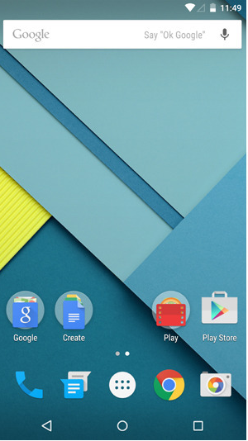
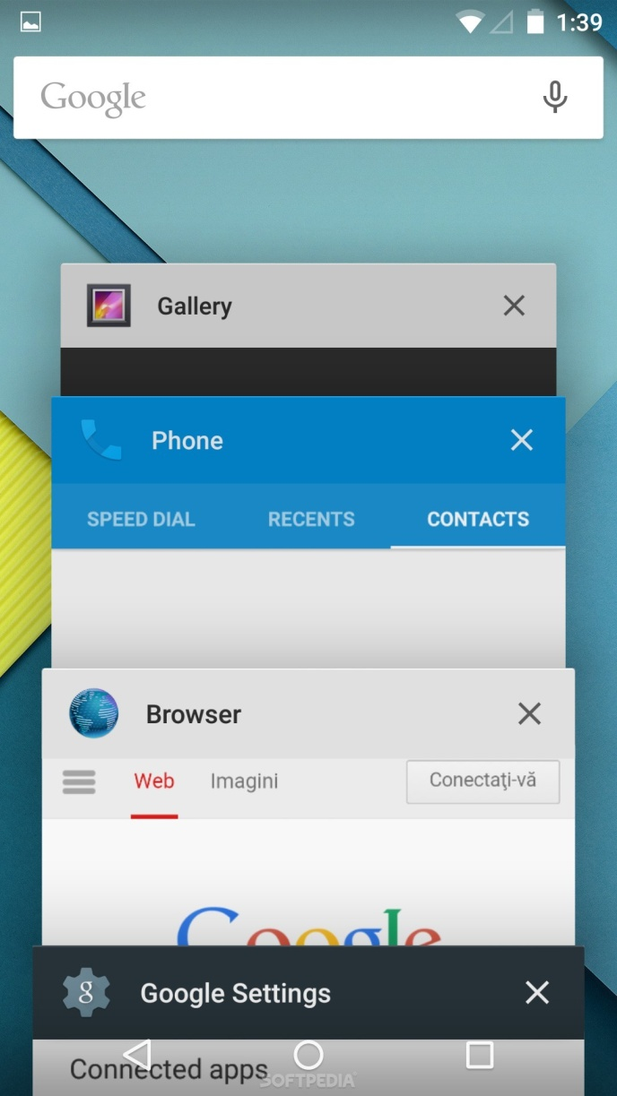
Android Home UI
Notification
Home App
System Back
Home
Recent Task

Slide 11
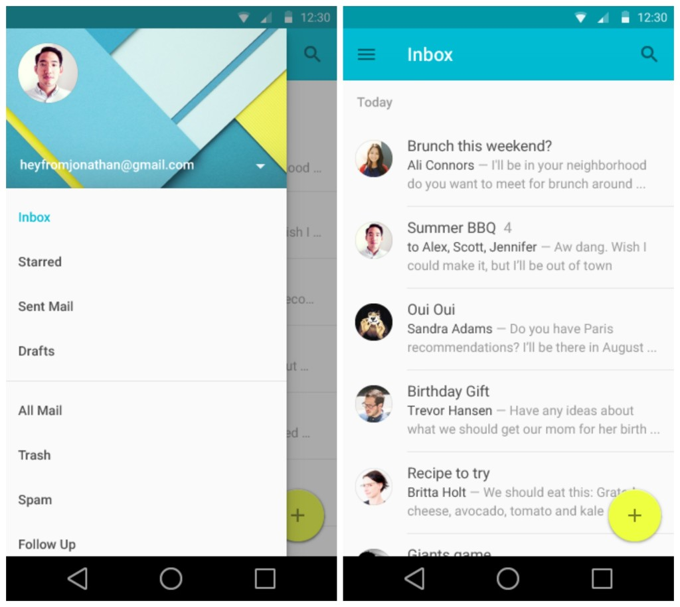
Android App UI
Action Bar
Navigation Drawer
Main Layout

Slide 12
Knowledge Fields to Hack Android
Main fields:
Embedded systems
Linux kernel internals
Device driver development
Unix system administration
GNU software development
Java-based development
Android app development

Slide 13
Agenda
Android Overview
Android System
Linux Kernel
Native System
Android Runtime
Application Framework
Android Application
How Android Works

Slide 14
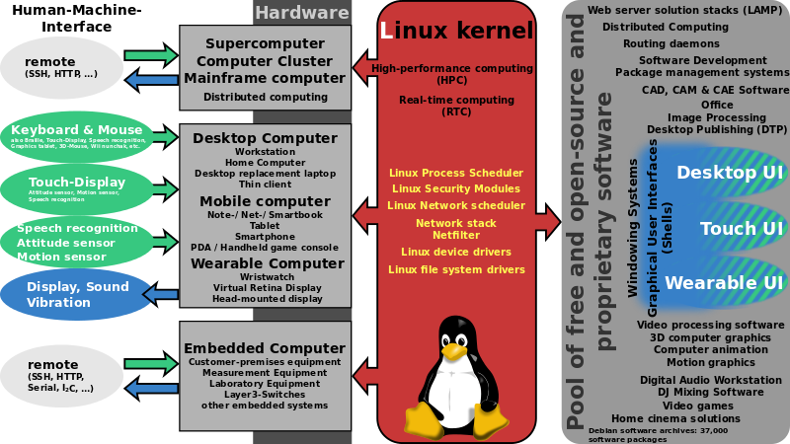
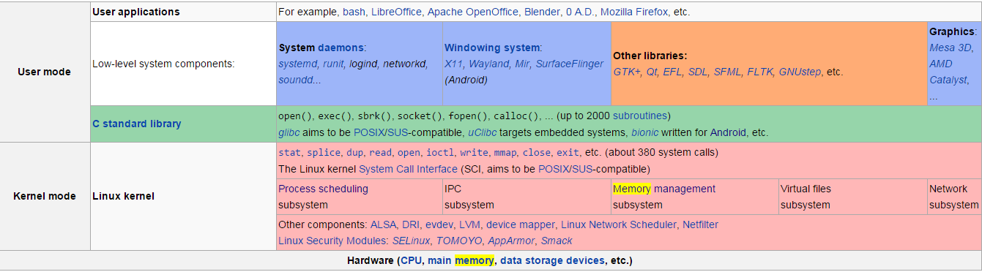
Linux Kernel Overview

Slide 15


Android vs. Linux
adb root
adb shell
/init.rc
/data/…
/system/…
/proc/…
/mnt/…

Slide 16
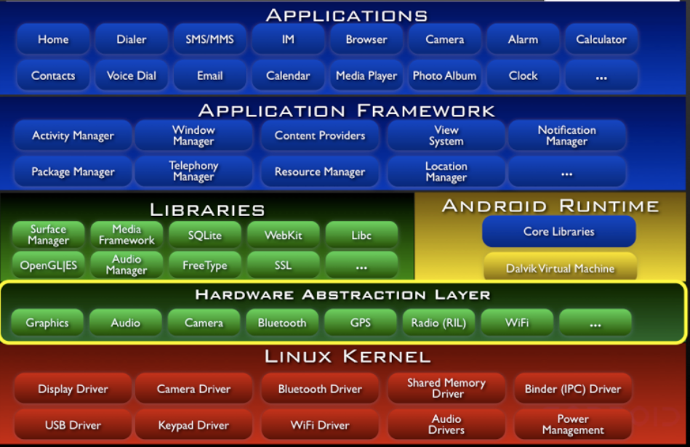
Android Architecture Overview
Java
Apache 2
C/C++ ASM
Kernel/ ASM
GPL

Slide 17
Licensing
The Android platform is licensed under the Apache Software License (ASL), excluding the kernel which is licensed under General Public License (GPL).
Apache license is considered to be more friendly towards commercial use, because it attempts to balance the open source goals with commercial market forces.
If there is NOT a financial incentive to deliver Android capable devices to the market, devices will Never appear in the meaningful volumes required to launch Android.

Slide 18
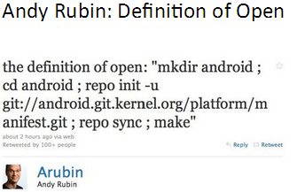
Android’s Open

Slide 19
Agenda
Android Overview
Android System
Linux Kernel
Native System
Android Runtime
Application Framework
Android Application
How Android Works

Slide 20
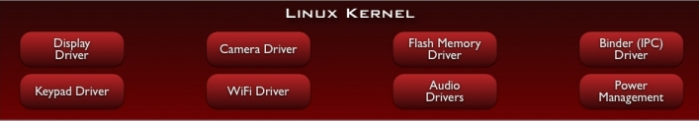
Linux Kernel Overview
Android is built on the Linux kernel, but Android is not Linux.
As of January 2014, current Android versions consist of a kernel based on the Linux kernel's long-term support (LTS) branch that 3.4 or newer, varying in version numbers depending on the actual Android device
Patch of “kernel enhancements” to support Android

Slide 21
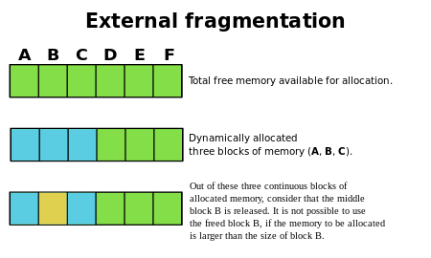
Why Linux Kernel (Open)
Memory management
Memory per process: virtual memory separate the memory addresses from actual physical addresses.
Memory efficiency: paging/swapping upon primary/secondary storage
IPC: Shared memory
Process ranking management (scheduling)
Permissions-based security model (sandbox)
Support for shared libraries (by executable files)
statically linked, modules are allocated memory when the executable file is created
Proven driver model

Slide 22
Kernel Enhancements
Alarm
Ashmem
Binder
Power Management
Low Memory Killer
Kernel Debugger
Logger

Slide 23
Binder: Problem to Sort Out
Applications and Services may run in separate processes but must communicate and share data
IPC can introduce significant processing overhead and security holes

Slide 24
Binder: How to Sort Out
Driver to facilitate inter-process communication IPC
High performance through shared memory
Per-process thread pool for processing requests
Reference counting, and mapping of object references across processes
Synchronous calls between processes

Slide 25
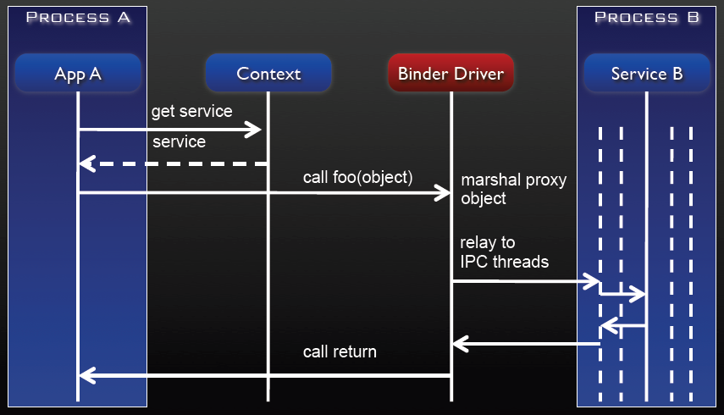
Binder: How it Works

Slide 26
PM: Problem to Sort Out
Mobile devices run on battery power
Batteries have limited capacity

Slide 27
PM: How to Sort Out
Built on top of standard Linux Power System
More aggressive power management policy
Components make requests to keep the power on through “wake locks”
Supports different types of wake locks

Slide 28
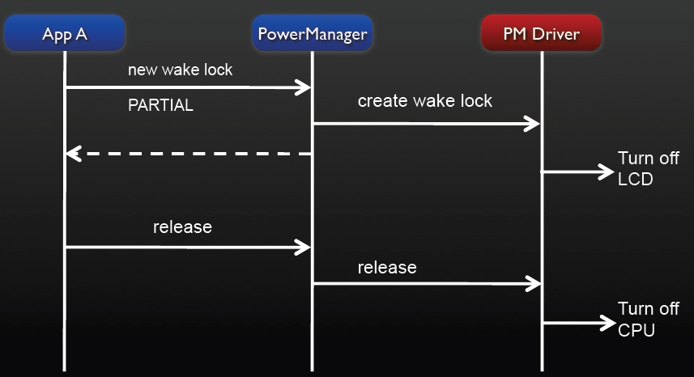
PM: How it Works

Slide 29
Agenda
Android Overview
Android System
Linux Kernel
Native System
Android Runtime
Application Framework
Android Application
How Android Works

Slide 30
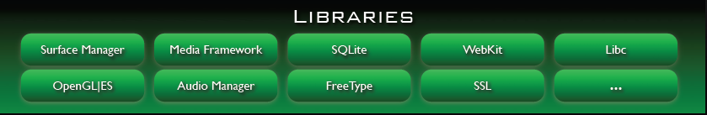
Native System
Bionic Libc
Libraries
Sub System
Hardware Abstraction Libraries

Slide 31
What is Bionic
Custom libc implementation, optimized for embedded use

Slide 32
Why Bionic
License: we want to keep GPL out of user-space
Bionic Libc is attributed as BSD license
Size: will load in each process, so it needs to be small
Fast: limited CPU power means we need to be fast

Slide 33
Bionic Libc Constraint
Doesn't support certain POSIX features
Not compatible with GNU Libc (glibc)
All native code must be compiled against bionic

Slide 34
Native System
Bionic Libc
Libraries
Sub System
Hardware Abstraction Libraries

Slide 35
Libraries - WebKit
Based on open source WebKit browser: http://webkit.org
Renders pages in full (desktop) view
Full CSS, Javascript, DOM, AJAX support

Slide 36
Libraries – Media Framework
Based on PacketVideo OpenCORE platform
Supports standard video, audio, still-frame formats
Support for hardware / software codec plug-ins

Slide 37
Libraries - SQLite
Light-weight transactional data store
Back end for most platform data storage

Slide 38
Native System
Bionic Libc
Libraries
Sub System
Hardware Abstraction Libraries

Slide 39
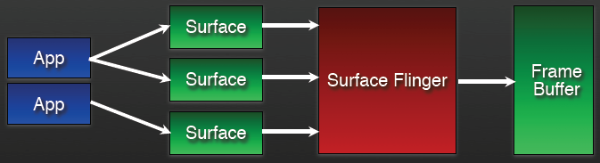
Sub Windowing System – Surface Flinger
Provides system-wide surface “composer”, handling all surface rendering to frame buffer device
Can combine 2D and 3D surfaces and surfaces from multiple applications
Surfaces passed as buffers via Binder IPC calls
Double-buffering using page-flip

Slide 40
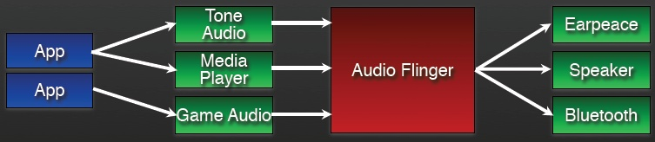
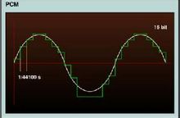
Sub Audio System – Audio Flinger
Manages all audio output devices
Processes multiple audio streams into PCM (Pulse-code modulation) audio out paths
Handles audio routing to various outputs

Slide 41
Native System
Bionic Libc
Libraries
Sub System
Hardware Abstraction Libraries

Slide 42
Hardware Abstraction Libraries
User space C/C++ library layer
Why HAL:
Defines the interface that Android requires hardware “drivers” to implement
Separates the Android platform logic from the hardware interface
Kernel drivers are GPL which exposes any proprietary IP

Slide 43
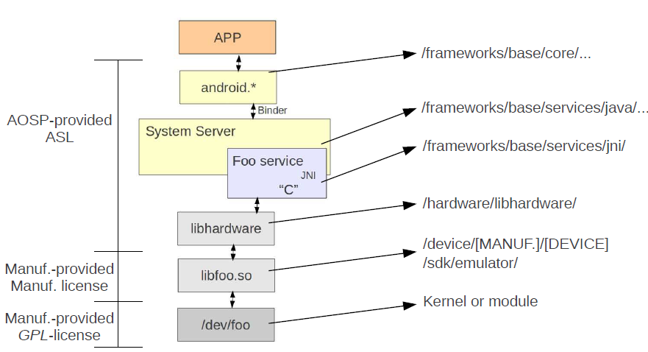
Hardware Abstraction Libraries

Slide 44
Agenda
Android Overview
Android System
Linux Kernel
Native System
Android Runtime
Application Framework
Android Application
How Android Works

Slide 45
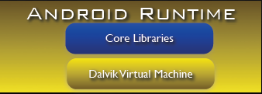
What Dalvik Virtual Machine
Androidʼs custom clean-room implementation virtual machine
Provides application portability and runtime consistency
Runs optimized file format (.dex) and Dalvik bytecode
Java .class / .jar files converted to .dex at build time
ART replaces DVM entirely in Android 5.0

Slide 46
Why Dalvik Virtual Machine (Embedded Sys)
Supports multiple VM processes per device
Highly CPU-optimized bytecode interpreter
Less instructions. Generally, stack-based machines like JVM must use instructions to load data on the stack and manipulate that data, thus, it requires more instructions than register based machines to implement the same code
Uses runtime memory very efficiently
Dalvik uses 16-bit instruction set that works directly on local variables instead of local variables must be copied to or from the stack by separate instructions
Less size
An uncompressed .dex file is typically a few percent smaller in size than a compressed JAR derived from the same .class files
Allows to mmap() the DEX file into memory to reduce system I/O. File contents are not entirely read from disk and do not use physical RAM at all

Slide 47
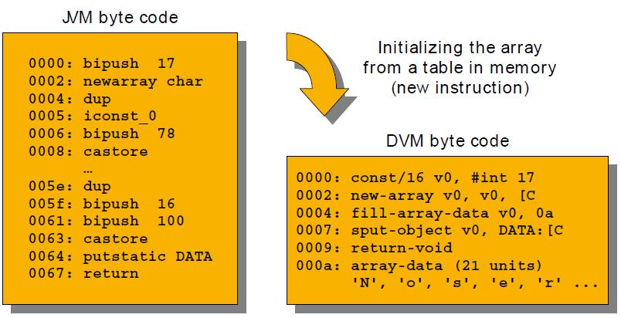
JVM byte vs. DVM byte

Slide 48
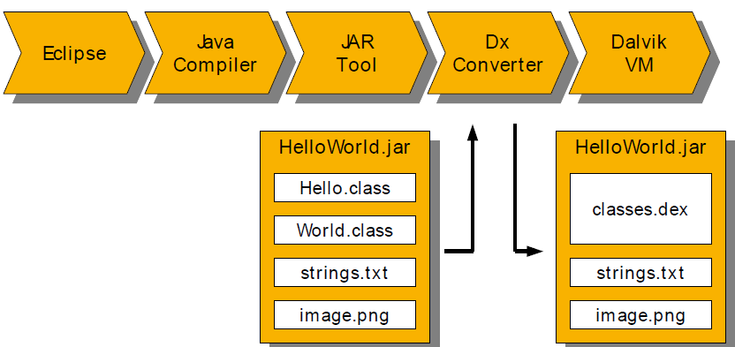
Java Class -> DEX

Slide 49
What Core Libraries
Core APIs for Java language provide a powerful, simple and familiar development platform
Set of libraries “close to“ the VM
Each device is supposed to provide them
Android framework builds upon them

Slide 50
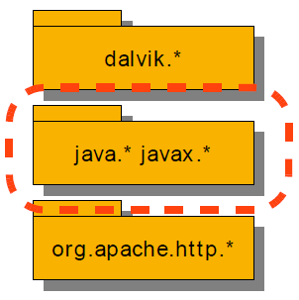
Composition of Core Libraries
Oracle vs. Google
Android does not use any Oracle Java libraries or JVM in the final product, instead it relies on Apache Harmony and Dalvik instead.
Three (public) parts
Dalvik VM- specific libraries
System info, debugging, ...
Java compatibility libraries
Base and utility classes
Third- party utility libraries
Apache HttpClient 4.0

Slide 51
Agenda
Android Overview
Android System
Linux Kernel
Native System
Android Runtime
Application Framework
Android Application
How Android Works

Slide 52
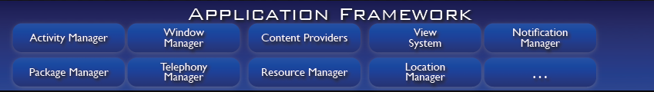
Core Platform Services
Services that are essential to the Android platform
Behind the scenes - applications typically don't access them directly
Activity Manager
Package Manager
Window Manager
Notification Manager
Resource Manager
Content Providers
View System

Slide 53
Breakdown
Activity Manager - Manages the lifecycle of applications and provides a common navigation backstack
Package Manager - Retrieving various kinds of information related to the application packages that are currently installed on the device
Window Manager - The interface that apps use to talk to the window manager
Notification Manager - Enables all applications to display custom alerts in the status bar
Resource Manager - Providing access to non-code resources such as localized strings, graphics, and layout files
Content Providers - Enable applications to access data from other applications (such as Contacts), or to share their own data
View System - Represents the basic building block for user interface components

Slide 54
Hardware Oriented Services
Provide access to lower-level hardware APIs
Typically accessed through local Manager object
LocationManager lm = (LocationManager)
Context.getSystemService(Context.LOCATION_SERVICE);
Telephony Service
Location Service
Bluetooth Service
WiFi Service
USB Service
Sensor Service

Slide 55
Breakdown
Telephony Service - Provides access to information about the telephony services on the device
Location Service - Provides access to the system location services
Bluetooth Service - Provides access to the Bluetooth functionality through the Android Bluetooth APIs
WiFi Service - Provides the primary API for managing all aspects of Wi-Fi connectivity
USB Service - Provides access to the state of USB and communicate with USB devices
Sensor Service - Provides access to the device's sensors

Slide 56
Agenda
Android Overview
Android System
Linux Kernel
Native System
Android Runtime
Application Framework
Android Application
How Android Works

Slide 57
What Android Application
All the code in a single .apk file is considered to be one application
Each application is a different user in android system
By default, Each ach application has a unique Linux user ID (the ID is used only by the system and is unknown to the application).
Each process has its own virtual machine (VM)
By default, every application runs in its own Linux process, so an application's code runs in isolation from other applications.

Slide 58
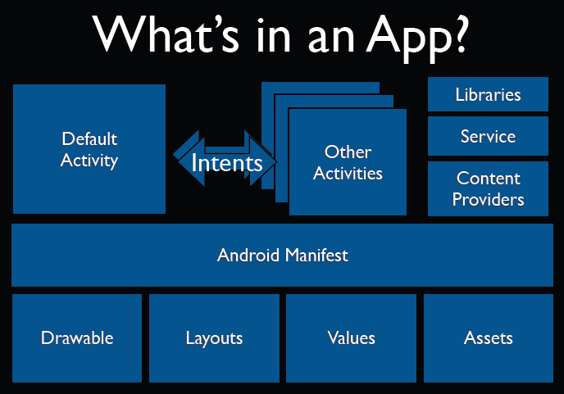
What is in a Android app

Slide 59
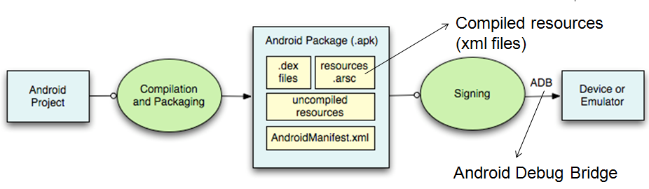
Android App Compilation Level 1
ADB is a client server program that connects clients on developer machine to devices/emulators to facilitate development.
An IDE like Eclipse handles this entire process for you.

Slide 60
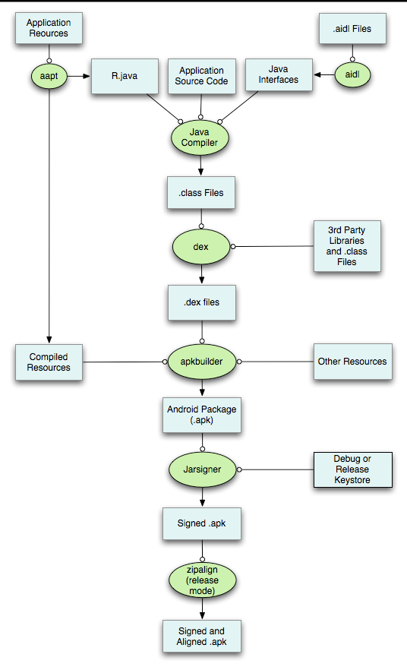
Android App Compilation Level 2
Android Interface Definition Language (AIDL) – Definitions to exchange data between applications (just like SOAP )
Jarsigner to help on signing application with certificate key saved in key store
Zipalign to help on optimizing the size of APK file in 4 bytes alignment
Android Asset Packing Tool
Allows processes across apps to communicate.

Slide 61
Agenda
Android Overview
Android System
Linux Kernel
Native System
Android Runtime
Application Framework
Android Application
How Android Works

Slide 62
Overview
Bootloader
Kernel
Init
Zygote
System Server
Activity Manager
Launcher (Home)

Slide 63
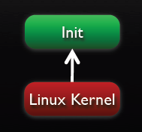
Runtime Walkthrough
It all starts with init…
Similar to most Linux-based systems at startup, the bootloader loads the Linux kernel and starts the init process.

Slide 64
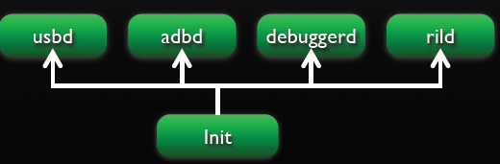
Runtime Walkthrough
Init starts Linux daemons, including:
USB Daemon (usbd) to manage USB connections
Android Debug Bridge (adbd) to manage ADB connections
Debugger Daemon (debuggerd) to manage debug processes requests (dump memory, etc.)
Radio Interface Layer Daemon (rild) to manage communication with the radio

Slide 65
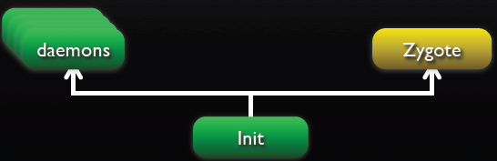
Runtime Walkthrough
Init process starts the zygote process:
A “early” process which initializes a Dalvik VM instance
Loads classes and listens on socket for requests to spawn VMs
Forks on request to create VM instances for managed processes
Copy-on-write to maximize re-use and minimize footprint

Slide 66
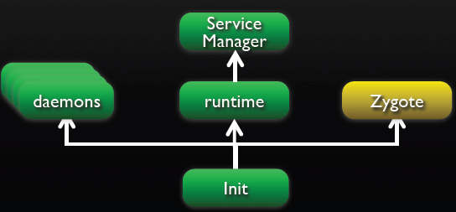
Runtime Walkthrough
Init starts runtime process:
Initializes Service Manager – the context manager for Binder that handles service registration and lookup
Registers Service Manager as default context manager for Binder services

Slide 67
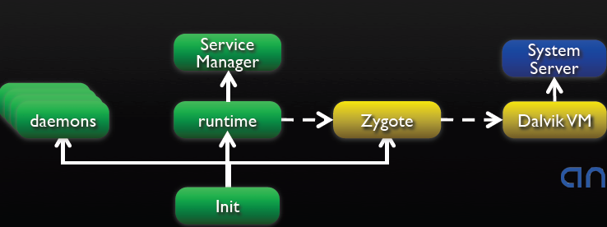
Runtime Walkthrough
Runtime process sends request for Zygote to start System Server
Zygote forks a new VM instance for the System Service process

Slide 68
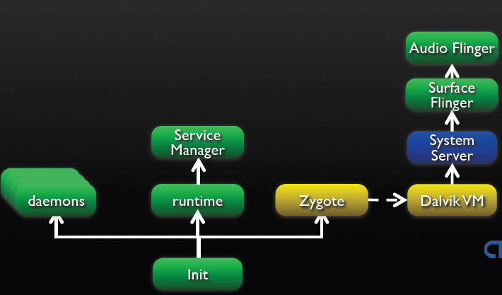
Runtime Walkthrough
System Server process starts the native sub system, including:
Surface Flinger
Audio Flinger, …

Slide 69
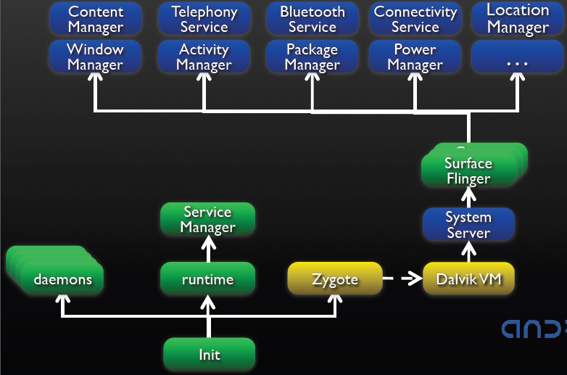
Runtime Walkthrough
System Server process starts the Android managed services:

Slide 70
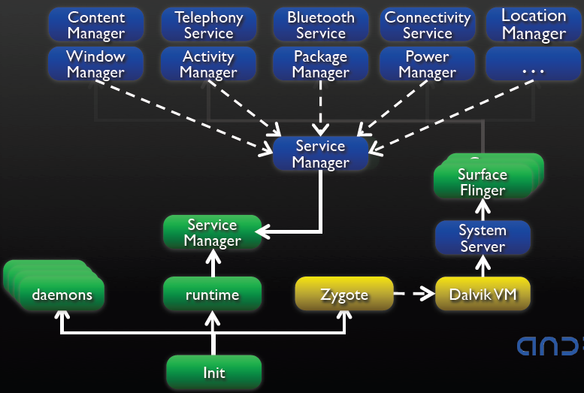
Runtime Walkthrough
Android managed services register to Service Manager via SM context/context mgr:

Slide 71
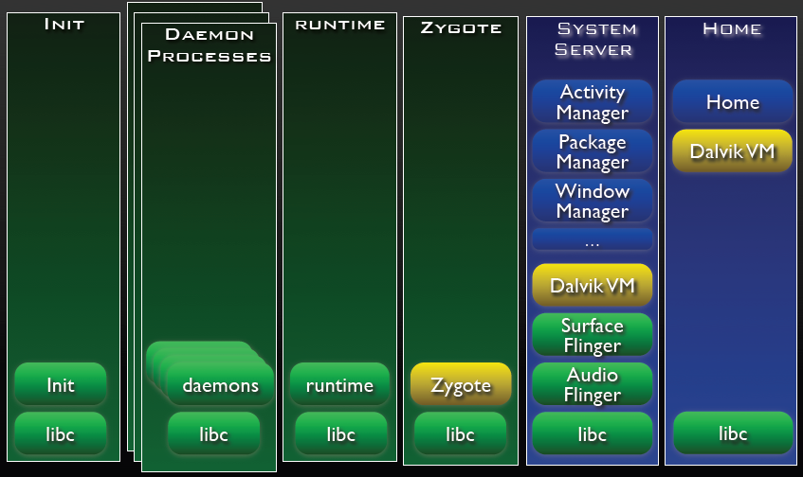
Runtime Walkthrough
After system server loads all services, the system is ready…

Slide 72
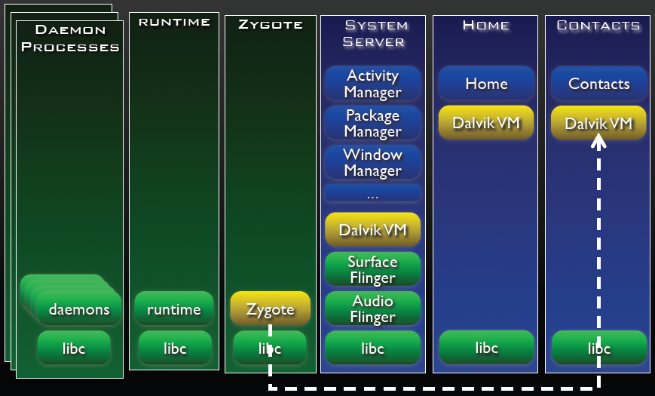
Runtime Walkthrough
Each subsequent application is launched in itʼs own process

Slide 73

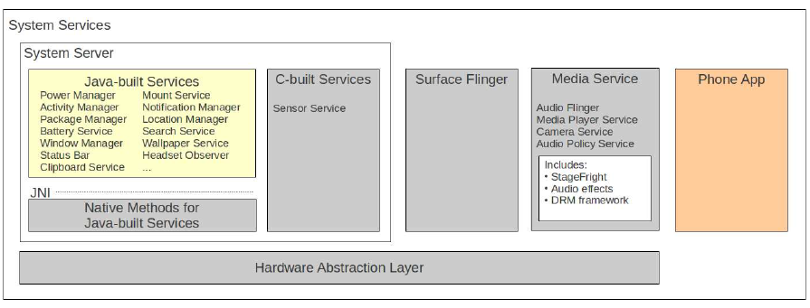
What does System Services mean in Android

Slide 74
Interaction between Layers
There are 3 main flavors of Android layer cake:
App -> Runtime Service -> lib
App -> Runtime Service -> Sub System -> lib
App -> Runtime Service -> Native Daemon -> lib

Slide 75
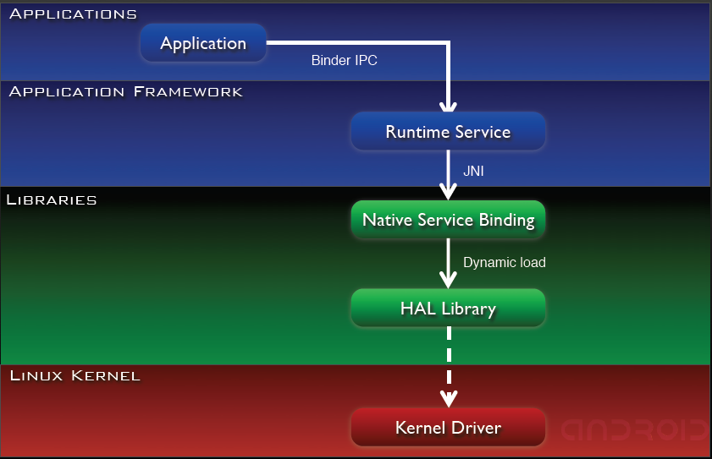
App -> System Service

Slide 76
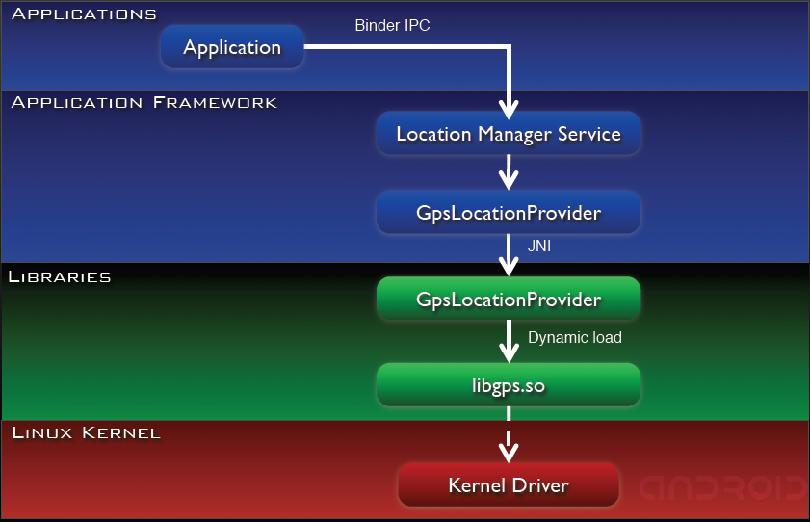
Example: Location Manager

Slide 77
Interaction between Layers
There are 3 main flavors of Android layer cake:
App -> Runtime Service -> lib
App -> Runtime Service -> Sub System -> lib
App -> Runtime Service -> Native Daemon -> lib

Slide 78
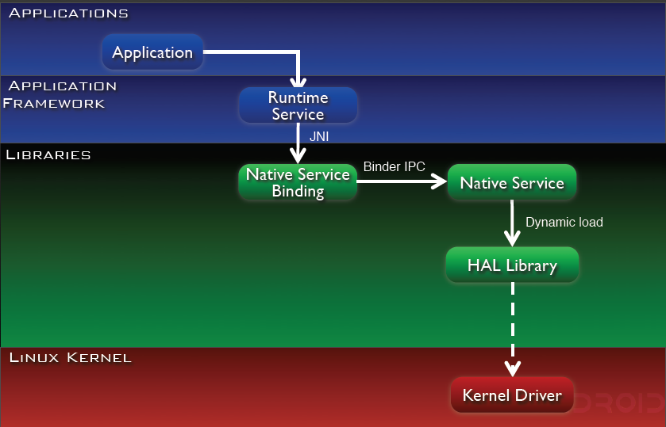
App -> System Service -> Sub System

Slide 79
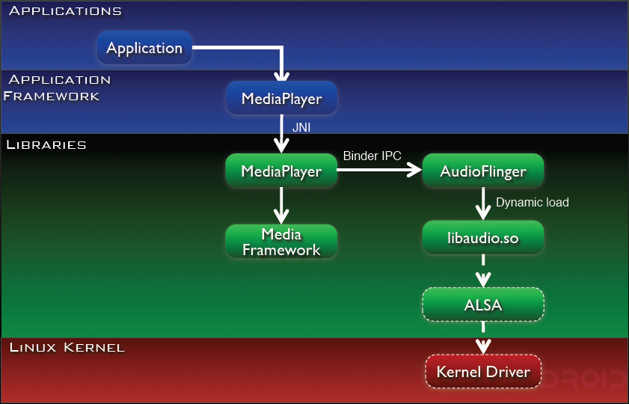
Example: AudioFlinger Sub System

Slide 80
Interaction between Layers
There are 3 main flavors of Android layer cake:
App -> Runtime Service -> lib
App -> Runtime Service -> Sub System -> lib
App -> Runtime Service -> Native Daemon -> lib

Slide 81
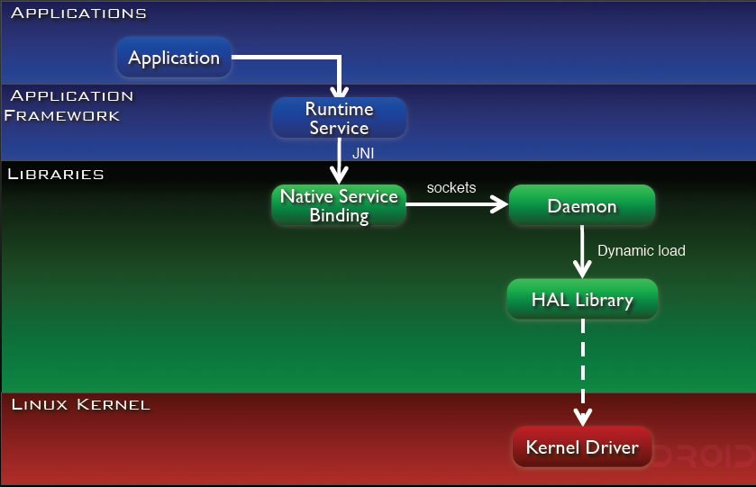
App -> System Service -> Daemon

Slide 82
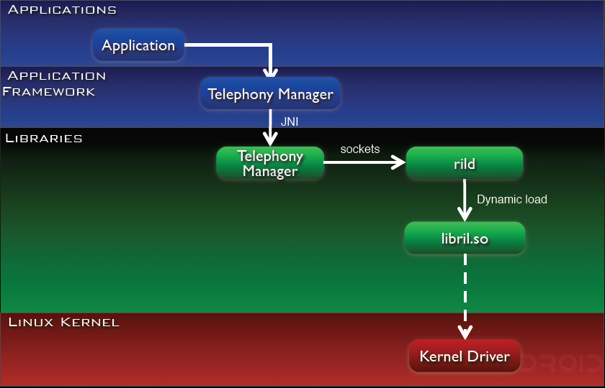
Example: rild

Slide 83
The Most Notable Service - ActivityManager
Start new Activities, Services
Fetch Content Providers
Intent broadcasting
OOM adj. maintenance
Application Not Responding
Permissions
Task management
Lifecycle management

Slide 84
Reference
Android Developer:
http://developer.android.com/index.html
Anatomy Physiology of An Android: http://androidteam.googlecode.com/files/Anatomy-Physiology-of-an-Android.pdf
SlideShare – Android Development:
http://www.slideshare.net/mclougm4/android-development-6570689

